Slide 1
Endpoints Operations
Monthly Operations Summary
JL IT
November 2022

Slide 2
Executive Summary
Incident Management saw incident volume lower in November (2,928). The first call resolution, or FCR, was 85.1%. The overall SLA goal across all teams was met at 91.5%.
Service Desk call volume dropped to 2503 calls in November. Calls answered within 30-, 60-, and 90- seconds goals were surpassed. Average speed to answer was 25 seconds. The abandonment rate goal for the month was also surpassed at 5.55%. SLA goals were met by the Service Desk with an overall SLA score of 97.6%.
~
Technology Operations assignment groups opened or received 437 incidents across the month. Critical Alerts increased to 289 in September. We still need to work on fine-tuning Logic Monitor thresholds and make sure Jackson Lewis and third parties are putting equipment in SDT mode to avoid false positive outages.
Endpoint Engineering Successfully moving through our test regimes(JL Core, JL Pilot) using Company Portal as primary deployment agent. Finalizing plans for Egress, Litera, Kofax and Netdocs to deploy to majority of the firm by years end. Troubleshooting and resolving issues found in Autopilot/AAD joined devices as SMEs are testing workflows for their specific roles. CIS Policies are currently in pilot and we're monitoring any issues/workflow blocks that these could cause.
Endpoint Projects NextGen was put on hold in September. Self Service Password Reset is currently being patched on the domain controllers. We are awaiting confirmation before rolling it out nationwide. Final amenities form for the Conference Room project was updated and configured in our test environment. Working with Microsoft on getting all rooms to show up in the Outlook Roomfinder before training the OA’s and department managers.

Slide 3
Incident Management Summary
Service Desk Summary
Technology Operations Summary
Endpoint Engineering Summary

Slide 4
Incident Management

Slide 5
Incident Statistics
2,928 incidents were opened during the month, across all groups within SNOW. 20.9% of incident volume were emails.
Phone: 2248
Email: 611
Self-Service: 48
Walk-in: 21
First contact resolution lowered slightly in November to 85.1% (as opposed to 83.8% in October).

Slide 6
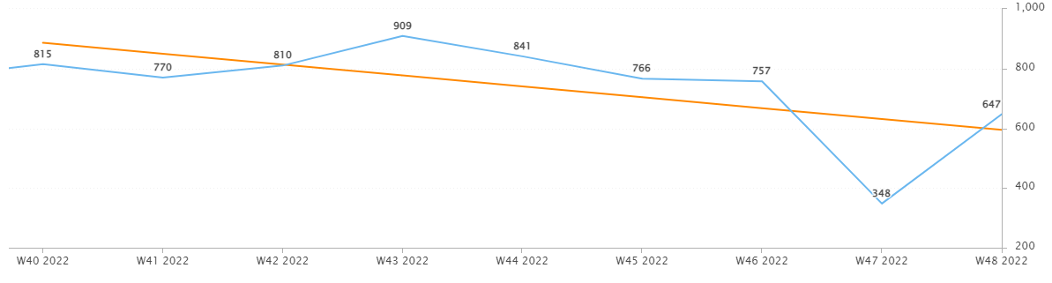
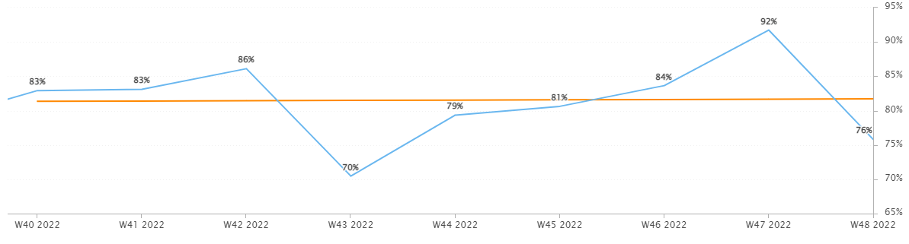
Incident Statistics
Incidents Opened by Week
Incidents opened by week trended downward in November, due in part to short week for the holiday.
The percentage of incidents resolved the same day that they were opened spiked during the holiday week.
Percentage of incidents resolved; same day opened.

Slide 7
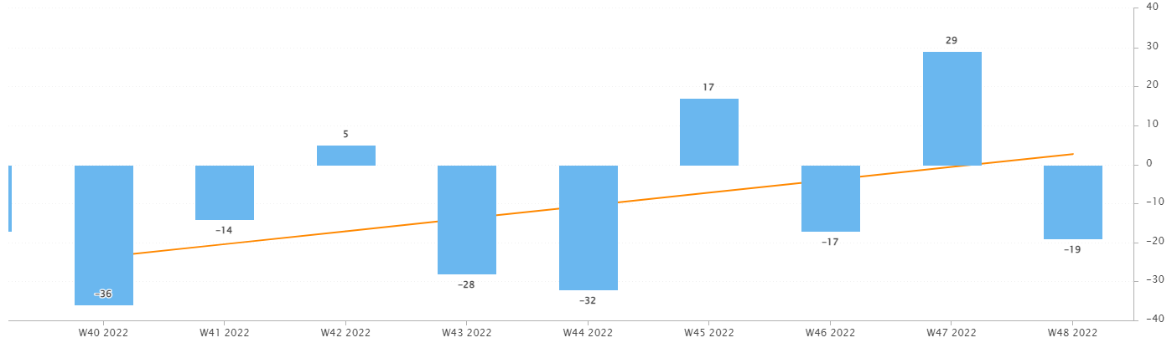
Incident Statistics
Open Incident Backlog Growth
In November, backlog growth trend upward. I’ve been pinging those with the oldest incidents and have been resolving items on behalf of other teams. Please remind your teams to work to resolve their assigned work.
As we approach 2023, we want to enter the new year with the smallest backlog as possible- across all teams. This applies to Problems as well.
Notes:
Backlog growth is a way of answering, “did we end the week with more or less incidents?”.

Slide 8
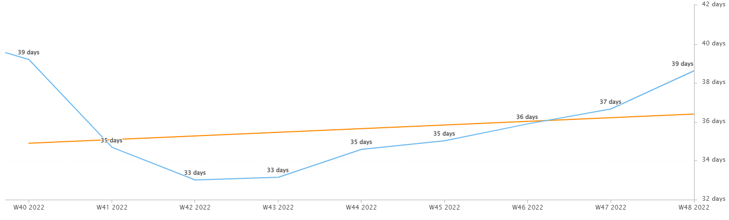
Incident Statistics
Average Age of Open Incidents
In November, the average age of open incidents steadily grew week over week.
Notes:
Please remind your teams to continue to work on their open incidents- this affects many of the previous slides as well as this one.

Slide 9
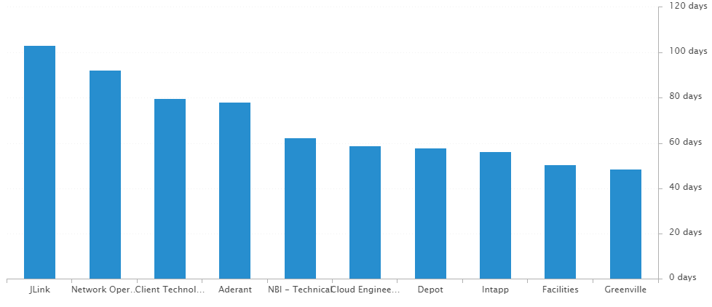
Incident Statistics
Average Age of Open Incidents by Assignment Group - as of the last day of the month

Slide 10
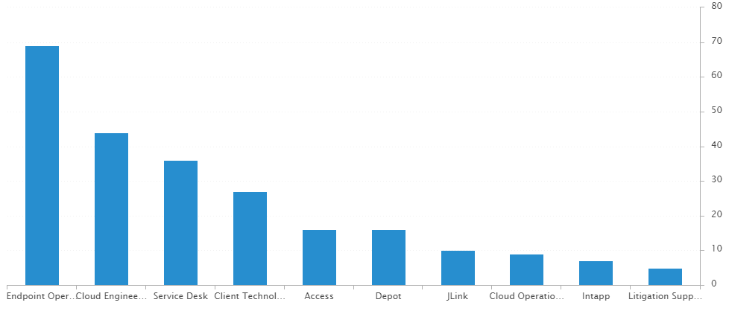
Incident Statistics
Open Incidents by Assignment Group - as of the last day of the month

Slide 11
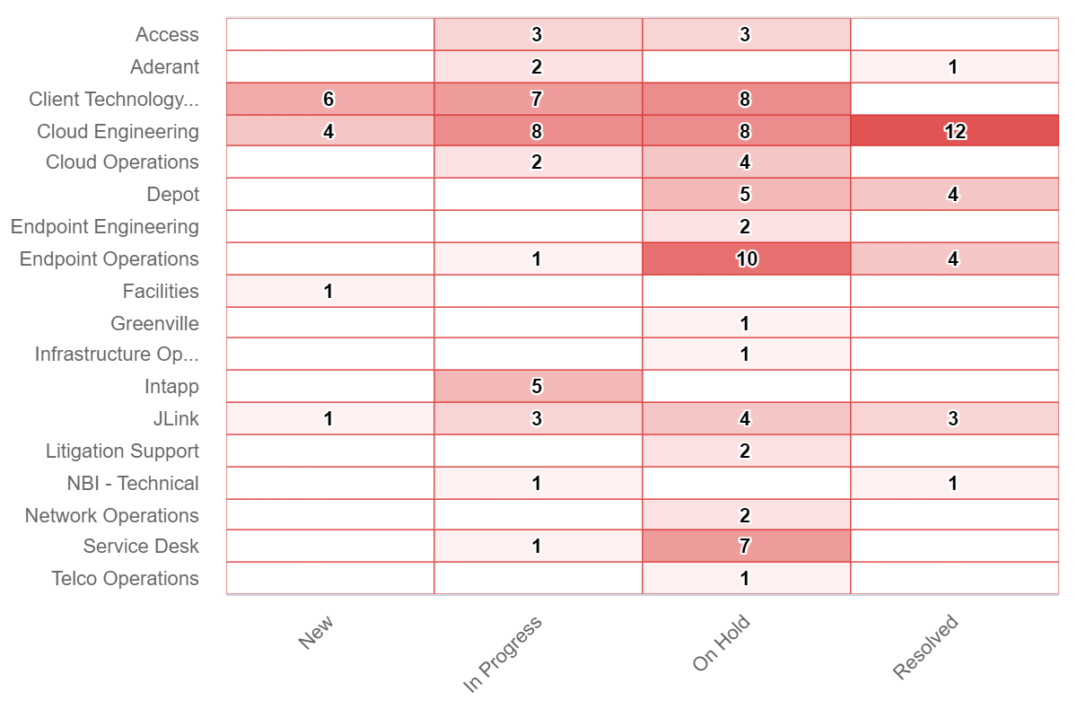
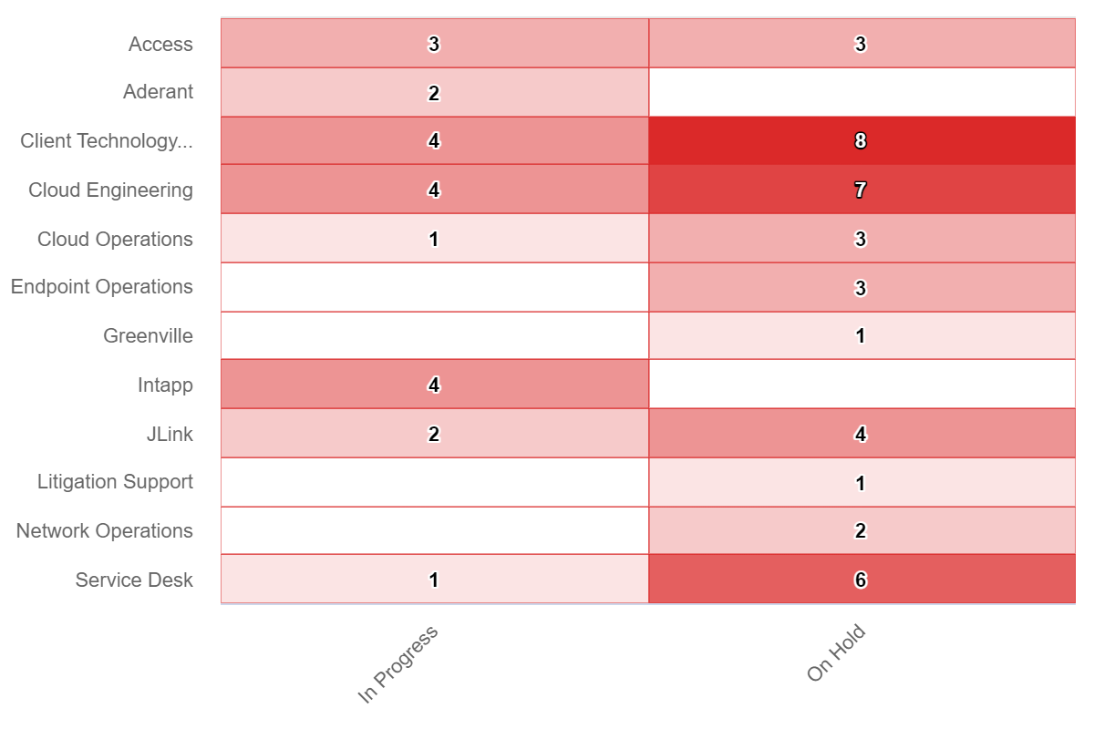
Incident Statistics
Open Incidents Older than 30 Days
Open Incidents not updated in last 30 days

Slide 12
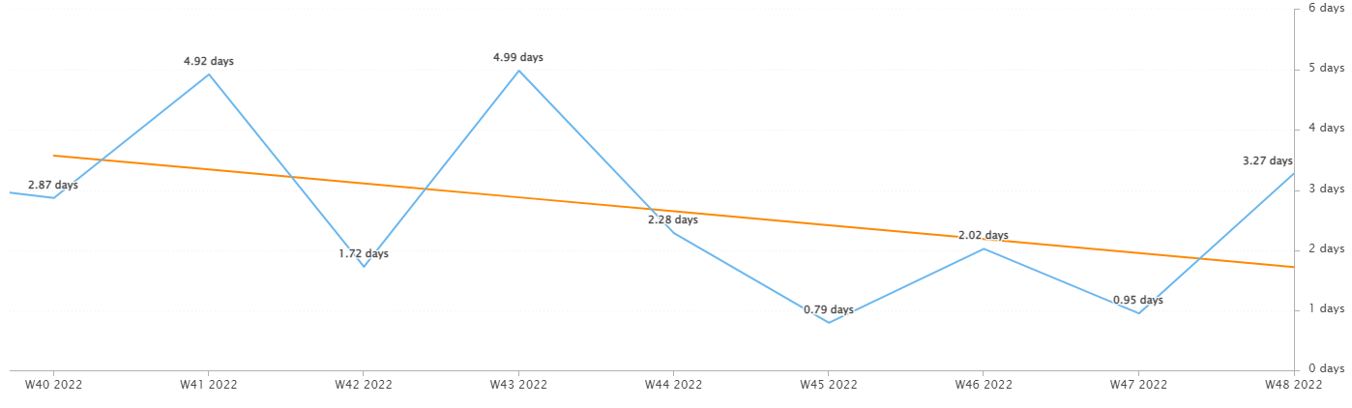
Incident Statistics
Average Resolution Time of All Resolved Incidents
The average resolution time trended downward across the month and rose within the last week.

Slide 13
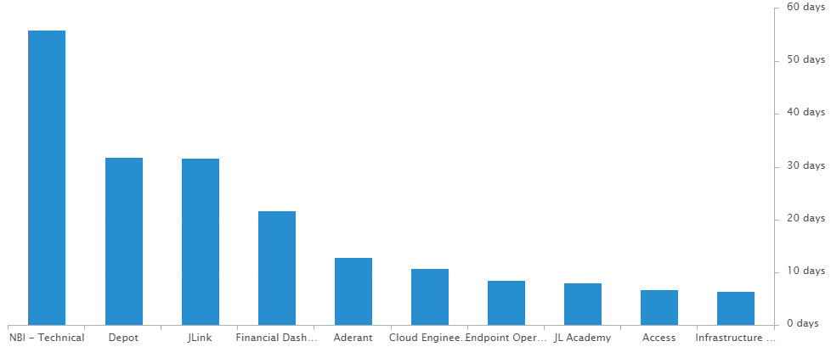
Incident Statistics
Average Resolution Time of Resolved Incidents, by Assignment Group

Slide 14
2022 SLA Goals & Actuals
Month | January | February | March | April | May | June | July | Aug | Sept | Oct | Nov | Dec
Goal | 90% | 90% | 90% | 90% | 90% | 90% | 90% | 90% | 90% | 90% | 90% | 90%
Actual | 88.8% | 88.1% | 92.7% | 92% | 90.6% | 93.9% | 91.6% | 91.2% | 90.7% | 89.9% | 91.5%
The Incident SLA goal in November was met.

Slide 15
Problem Statistics
Open Problems
Problem | Date of most recent update | Assignment Group
PRB0010189 | 2022-10-12 | Cloud Engineering
PRB0010541 | 2022-07-20 | Security
PRB0010542 | 2022-07-27 | Intapp
PRB0010543 | 2022-11-09 | Cloud Engineering
PRB0010587 | 2022-10-12 | Cloud Engineering
PRB0010595 | 2022-08-31 | Telco Operations
PRB0010598 | 2022-12-05 | Cloud Engineering
PRB0010606 | 2022-10-21 | Endpoint Engineering
PRB0010617 | 2022-11-02 | Endpoint Operations
PRB0010633 | 2022-11-01 | Net/Telco Engineering
PRB0010634 | 2022-12-01 | Cloud Operations
PRB0010638 | 2022-10-28 | Infrastructure Engineering
PRB0010650 | 2022-12-05 | Access
PRB0010653 | 2022-12-02 | Cloud Operations

Slide 16
Service Desk

Slide 17
Year over Year Quarterly Results
Total incident and call volume reduced in Q3 2022 over 2020 & 2021.

Slide 18
Key Call Statistics
Call volume dropped to 2503 calls in November. This drop is expected with less Problems opened than previous months and a holiday week.
The goal was met, ending the month with 5.55%.
The abandonment rate monthly goal is 9%.
Notes:
~
There are several stats tracked for individual analysts as well as for the team and the org. Across the next few slides I’ll highlight some key statistics for the Service Desk team.

Slide 19
Key Call Statistics
The Service Desk met all 3 goals for each range. This correlates with the call volume and abandonment rates.
The goals for each time period:
70% of calls handled within 30 seconds.
75% of calls handled within 60 seconds.
80% of calls handled within 90 seconds.
Notes:
Over 75% of calls were handled within 30 seconds.
Over 80% were handled within 60 seconds.
Over 83% were handled within 90 seconds.
~
We track multiple metrics for calls handled- or how quickly a call is answered- within specific time periods. I’ve highlighted three here, calls handled within 30, 60, and 90 seconds.
The takeaway from these numbers should be that we are answering calls quickly which prevents calls from abandoning. Typically, we see the abandoned calls rise when these goals are not met- specifically the 60 seconds metric.

Slide 20
Key Call Statistics
The average speed to answer was 25 seconds which correlates with the trend of call volume & abandoned calls alongside the higher percentages for the calls handled within 30, 60, and 90 seconds.
This is the best average speed to answer of the year, tied with June.
Notes:
~
Average speed to answer is the average of how quickly all calls were answered by the Service Desk for the month.

Slide 21
Incident Statistics
Closed Monthly Data:
Incidents closed by SD: 2818
Total Closed Incidents: 3,405
Closed by SD Percentage: 82.7%
Incidents closed by Service Desk, by Source:
Phone: 2,306
Email: 461
Self-Service: 31
Walk-in: 20
Notes:
~
The typical methods for contacting the Service Desk are phone and email, which explains the results in the incident source chart.
Self-Service we hope to expand over the next year and drive users towards generating their own incidents and using the JL Service Center more actively.
Walk-ins are low month-to-month with the split schedule for Return to Better. But from analyst feedback incidents for walk-ins are not being opened consistently. I aim to correct this over the rest of this year. I’ve also added it as a 2022 goal for each analyst within their reviews.

Slide 22
Incident Statistics
Top 5 Subcategories:
Microsoft Office (527)
Active Directory (430)
NetDocuments (348)
Power PDF (130)
Windows OS (124)
Top 5 Customers:
Greisy Ledo (33)
Pedro Forment (20)
Dawn Gann (19)
Betty Arnold (17)
Christopher Gomez (17)
Average Incident/employee/month: 1.5
Average Incident/new hire/month: 2.5
Notes:
Across the month _had the highest number of related incidents.
Top 5 customers in the month are listed here.
Looking at the chart, we’re tracking incident volume per new-hire per month and comparing this to last year.

Slide 23
2021 Service Desk SLA Statistics
Survey Response Comment Highlights:
Sandy – “The IT Support staff are always very knowledgeable and helpful and very much appreciated.
“Erica is amazing. …it's always so great to work with her because she is knowledgeable and friendly”
Blaise – “I have never experienced a better IT staff. they are quick, pleasant and successful.”
Dan – “IT was able to resolve it quickly and without much difficulty, and that was much appreciated.”
Chris – “The technician was helpful in fixing the problem and explaining what was wrong”
Brandon – “answered the call and assisted me was excellent! Thank you so much.”
September | Breached | Has not Breached | SLA %
Response | 98 | 2724 | 96.4%
Resolution | 32 | 2790 | 98.85%
Overall | 130 | 5514 | 97.64%
Response & Resolution SLA timers are determined by the Priority of the Incident.
Both Response and Resolution SLA reviewed on this slide are across all Priorities.
Notes:
Service level agreements/SLA
Response & Resolution SLA timers are determined by the Priority of the Incident.
Both Response and Resolution SLA reviewed on this slide are across all Priorities.
~ The Service Desk team is uniquely prepared to meet SLA goals. We generate incidents during calls, while emails generate their own incidents.

Slide 24
Knowledge Statistics
Top viewed articles, Self Service:
How to install a network printer
How do I contact the Service Desk?
How to configure JL email on your iOS device
Using AnyConnect for Remote Access (VPN)
Top viewed articles, IT:
Escalation paths and category guide
2Ring Dashboards
Netskope – Web Filtering & Exceptions
TeamViewer: Remote Control
Average Article rating: 4.67/5
Notes:
Knowledge within Service Now, is maintained by a few of us in the Service Desk team.
We evaluate resolved Incidents that have been flagged for knowledge.
On most of these flagged Incidents the fix or solution are not detailed by the escalated teams.
Knowledge is split into 2 sections. IT visible and Self-Service.
Please push your teams to write out the steps taken to resolve an issue, whenever possible.
This helps with knowledge but also helps when a user has a repeat issue, or the issue occurs for another user.
Reminder: your teams can generate their own knowledge articles. These will be used to increase our first call resolution and avoid escalating incidents.

Slide 25
Update & Reminder Highlights
JLink: Please be sure to evaluate issues reported with JLink to see if this issue is actually with the JLink site, or with a site linked to from within JLink.
Prior to escalating to this team, please to connect to the PC and review what the user is accessing to determine if the issue is with JLink.
Please include screenshots when possible.
The JLink team is working on creating a FAQ for our use and it will be added to knowledge once ready.
Microsoft Teams: There have been some reports of issues with quality of service within Teams meetings from some locations. Networking and Security are working to adjust Teams meetings to bypass the Netskope proxy.
TeamViewer Quick Support: The quick support file will be blocked without an exception. This is to meet Security’s requirements for remote access to our devices. If a user is working from a Jackson Lewis PC, add them to the Exception - TeamViewer distribution list within AD before asking them to browse to the TeamViewer link.
Litera: Litera is being sent out to the next wave of offices on November 28th. Atlanta, Baltimore, DC, Greenville, Hartford, Norfolk, Philadelphia, Providence, and Richmond all received the attached email giving an overview of the Litera Suite.
HelpDesk Voicemail: The issue occurring with voicemails left at the help desk line not migrating to Service Now have been resolved. Voicemail left at our line will be sent directly to SNOW and generate an incident and will not show up in the helpdesk@jacksonlewis.com mailbox.
OA Changes: Kim Webster and Cora Wilke are newly hired OAs who each started with JL this week.
Kim is handling St. Louis, Philadelphia, and Birmingham.
Cora is handling Greenville and Atlanta.
Notes:
Some highlights from the month’s U&R emails are listed here.
One to two emails are sent a week to the Service Desk reminding them, or updating them on, changes to existing workflows or policies. Quick notes sent via Teams are also rolled up into these emails to be sure that these points are not missed. All U&R emails are listed in Confluence for reference by other teams.

Slide 26
Technology Operations

Slide 27
Escalation Status

Slide 28
Escalation Baselines

Slide 29
Logic Monitor Alerts
Critical Alerts:
Extending the daily SDT for clocktimizer
Switches – Stack State and Idle interval (Health Probe Failed)
Error Alerts:
1223 alerts CPU Spikes
Vm-caris-col-01 ( Varonis Azure VM)
vm-eus2-mat02 ( Matallion Azure VM)
Azure Domain Controllers
JL-SN-MID-E01 ( Service Now discovery Server)
JLNOVITEK-E01 (Novitek Server)
485 Alerts on Silver Peaks
455 Alerts on Reboots ( Servers failed to be placed In SDT)

Slide 30
Resource Uptime
Resource | August | September | October
Aderant | 100% | 99.936% | 99.992%
Intapp Walls | 100% | 100% | 100%
JL - Home | 99.503% | 44.393% | 99.934%
JLink | 99.996% | 99.922% | 99.993%
NBI | 99.525% | 44.427% | 99.938%
Payments Credit Card | 99.957% | 100% | 100%
Dashboard | 100% | 100% | 99.998%
Biscom | 99.997% | 100% | 100%
Citrix | 100% | 99.928% | 99.987%
VPN East | 99.997% | 100% | 100%
VPN West | 99.73% | 99.973% | 99.982%
Logic Monitor Collector Polling
Similar the previous month.

Slide 31
Endpoint Engineering

Slide 32
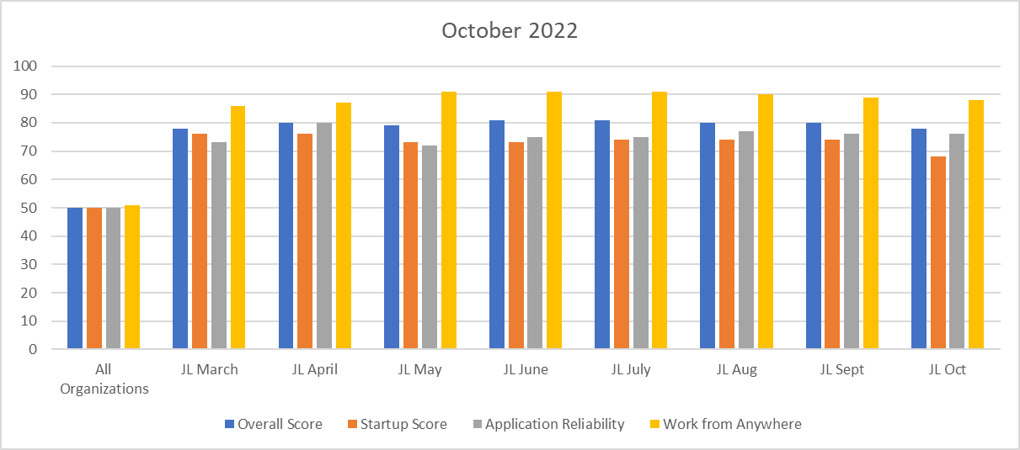
Endpoint Analytics
Overall score fell one point to 78 from September primarily due to remaining 21H2s Feature Update deployed into production.
App Reliability score of 76 due to staying current with updates and app versions of our base image.
Work From Anywhere score of 86 due to our SCCM CMG still out of service. Currently working with MS to resolve.

Slide 33
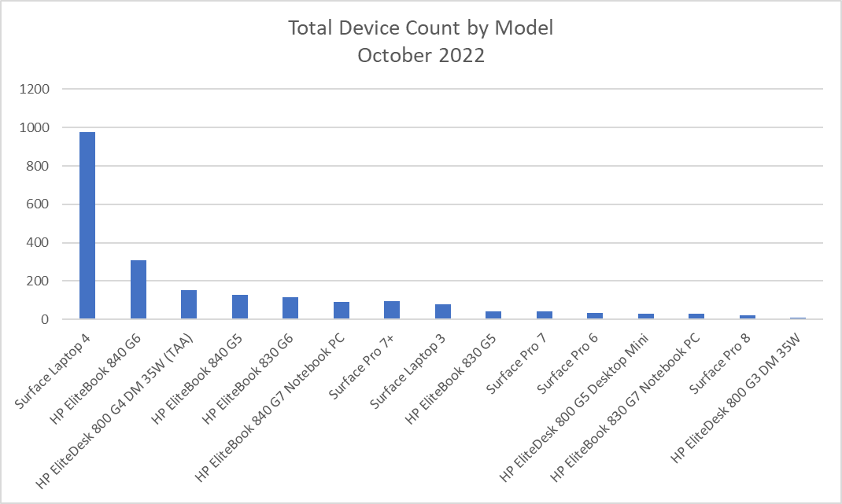
Endpoint Model Inventory
Continuing the trend of replacing our hardware with Microsoft products, giving us increased performance and reliability.
975 total Surface Laptop 4s – Best overall performer
13 Remaining Surface Pro 5s - Worst overall performer

Slide 34
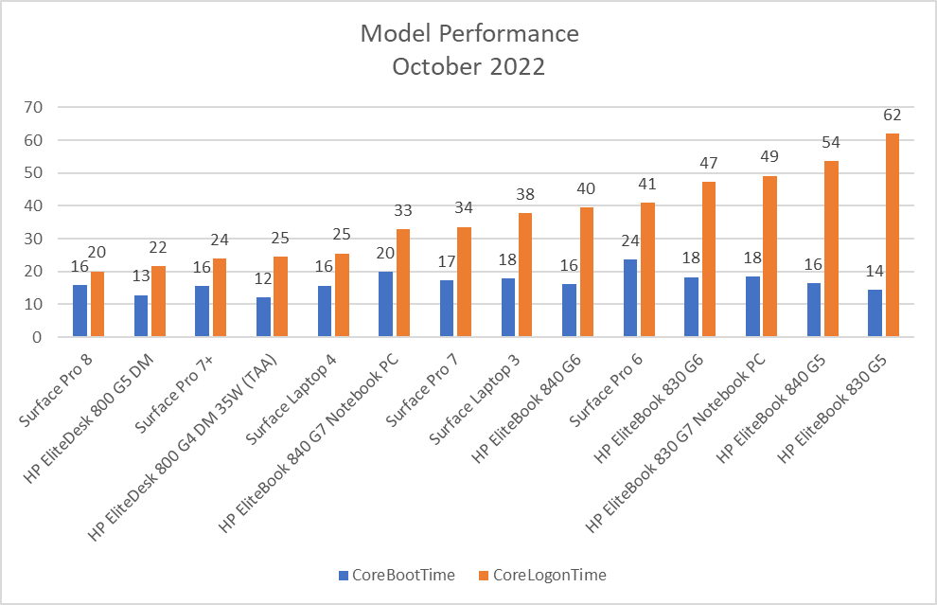
Endpoint Model Performance
Continuing to phase out older models with our latest models, Surface Pro 7+, Surface Pro 8 and Surface Laptop 4 allowing users to boot quicker, sign-in quicker and increase their productivity.

Slide 35
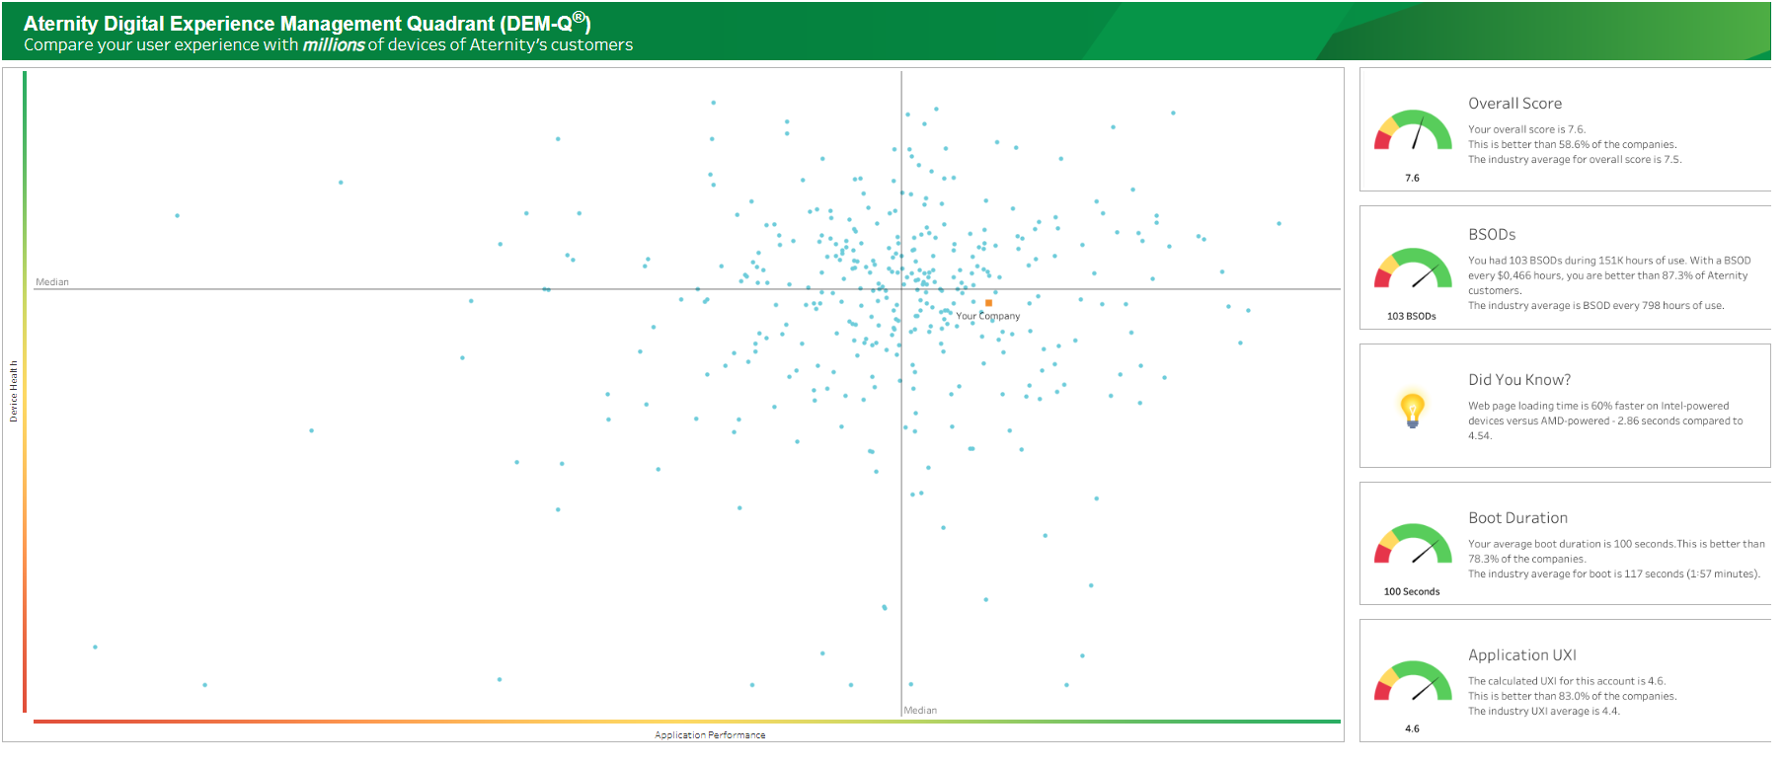
Aternity DEM-Q Performance
DEM-Q fell 4 points to 7.6 from September. We expect this number to rise back to the 8s once WUfB production ring for October fully reaches production.
Boot duration fell to by 2 seconds to 100sec from September
App UXI is still holding at 4.6, and increased to be better than 83.0% of companies.

